Slide 1



Fuel Consumption Modeling
Project 2 Part 3
By Tanner Gorman

Slide 2


Objectives
- Intro and Background of the Data
-The Cleaning Steps
-Exploratory Visuals
- Unique Challenges

Slide 3
Into and Background Of The Data
Data Initially obtained from: https://www.kaggle.com/datasets/rinichristy/2022-fuel-consumption-ratings
Data provided goes over cars manufactured in Canada in 2022, and their fuel consumption.
Features such as Engine size as well as Smog and CO2 are all provided as well as city and highway fuel consumption.
Data is suited for predictive modeling on a target of Combined Miles Per Gallon.
Goal: to be able to predict MPG of a vehicle based upon specific features.
Example: If engine size this and made by this manufacturer ‘x’ would be the predicted MPG

Slide 4
The Cleaning Steps Part 1
When cleaning data we have a standard look across all data sets together we will walk through these steps to Identify the process taken in forming the data when creating our predictive model!
Step1: Look at the shape of the data
Here we look at how many how many columns and how many rows the data set has.
For our data we have 946 Rows and 15 Columns
This is important to know as we go further in our data cleaning process (we will use this information later)
Step 2: Look at the Columns (Features).
Here we take an initial look at the columns and look to see if there is anything we need to change or delete to better represent the data and give our model and presentation a better chance to be accurate and effective in interpretation.
Column Drop 1: Column ‘Year’ is a bit redundant as data is for cars produced in the year 2022 all data in this column should be presented as 2022.
After verifying this is correct in the data, I have made the decision to drop this column.

Slide 5
The Cleaning Steps Part 2
Step 2: Look at the Columns (Cont.).
Column Drop 2: Column ‘Fuel Consumption Combined’ This is a redundant column as well and is served better in a later column in US fuel consumption combined..
Column Drop 3: Column ‘Model’ This column is too unique to provide adequate modeling as each model typing is unique correlation would be 1:1 and not assist in prediction.
Here we can also identify perhaps some terminology or metrics errors.
In my data set the data for MPG is in the L/100km as well as Imperial MPG as this presentation is in the US these metrics would be more effectively understood.
If I converted the data, as well as the column names to be more easily understood for my target audience.
Column Name Change: City & Hwy L/100km to U.S. City MPG and U.S. Hwy MPG.

Slide 6
The Cleaning Steps Part 3
Step 3: Check For Missing Values.
Sometimes data given may have missing or Nan values, our data set does not have this, but it is important to understand how we address these issues.
If Missing or nan data is relatively small number of cases, we would simply delete or drop those rows.
If Missing is large enough as to impact overall data represented, we could imput all columns with the mean value or most frequently occurring value.
If neither of these two options seems relevant the option to return data to the provider and ask for clarification and resubmission of data for processing.
No Missing data is in our data set so none of the above steps were taken while processing/ cleaning.

Slide 7
The Cleaning Steps Part 4
Step 4: Check for duplicates
Now when initially running through the data set no duplicate values were identified.
After column removal of the ‘Model’ there were 103 duplicates Identified.
Now knowing that initially they were not duplicates makes them valuable data points not just copies of previous points in the data set.
Removing these could potentially skew our data and predictive capabilities as they do represent actual data.
If however, this were not the case removing these data points would be advised as this would could perhaps skew our data set and potentially lead us to a less accurate model.
For this data set I am choosing to leave the duplicates identified.

Slide 8
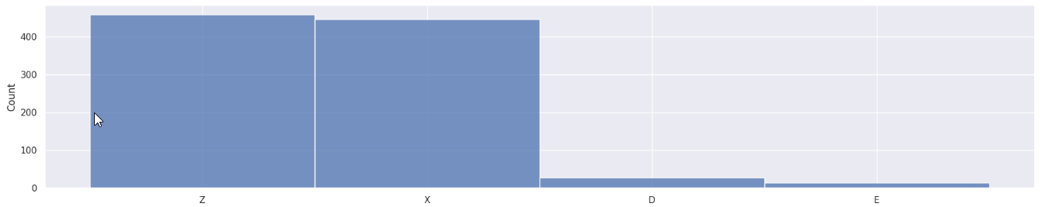
Exploratory Visuals
Seaborn Bar Chart.
I had some extreme data points in my target upwards of 70 MPG was thinking of removing them but after reviewing this It was found that some electric vehicles are in the data set that made me rethink this and keep them in the data set.
E is represented here as a fuel that is electric that can explain the outlier's id combined mpg visual.

Slide 9
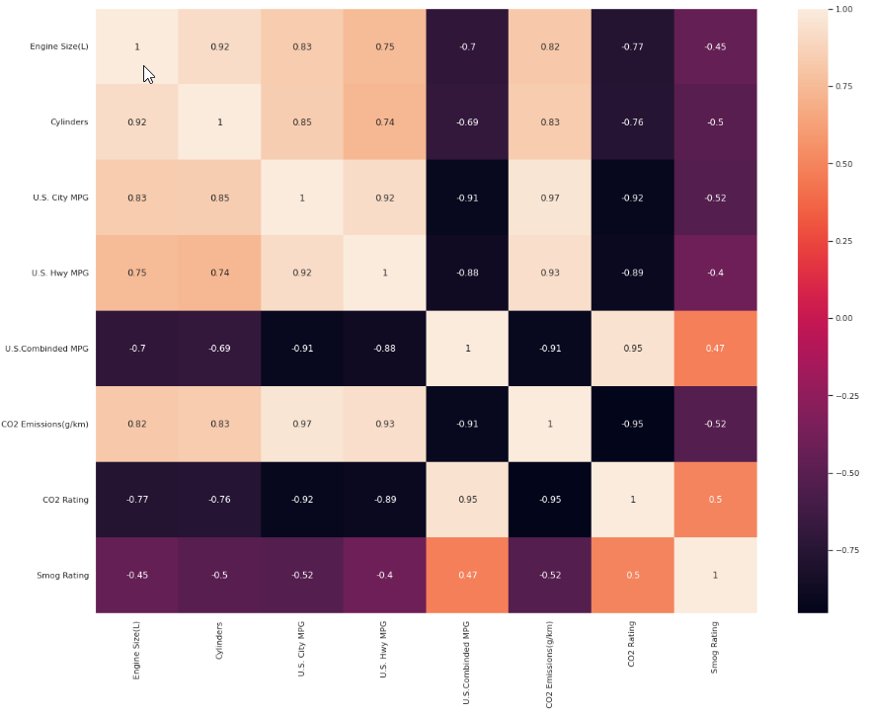
Exploratory Visuals
Multi-Variate Color Map.
This visual allowed me to view positive and negative correlation of all features left in the data set after cleaning steps were completed.
This will help determine features to use in predictive model.

Slide 10
Unique Challenges
Conversions for the l/100km and Imperial MPG to US MPG were exceptionally difficult as 2 conversions had to take place.
For l/100km all values had to be multiplied by 2.352145
For the Imperial to US conversion the values in that column needed to be divided by 1.02
To tackle this issue, I had to reach out for the most appropriate way to deal with these conversions. This involved reaching out to SME and getting assistance with coding as well as confirming that keeping the features rather than dropping this data would be advantageous to future modeling.

